Slide 1
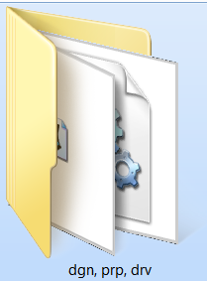
3wilD
Smart Plant PDS or Design Review conversion to Aveva PDMS / E3D
1
Three simple steps
3
2
Provide your Microstation files
We run them through our conversion software
*.dmp,
*.l.t,
PDS Oracle RIS dump text files
or
…and provide a fully functioning, intelligent & unlocked PDMS design database (& catalogues*)
Smart Plant Design Review files
*.dgn,
*.prp,
*.drv
Via secure FTP site
* Full PDS data set required
By Threewild.com, email info@threewild.com Located in Australia
28 years experience in PDS and PDMS design systems and projects in the Oil, Gas & Mining industries
Click for Next Slide
Intergraph Smart Plant Design Review conversion to PDMS E3D PDS translate convert modify save as Navisworks

Slide 2
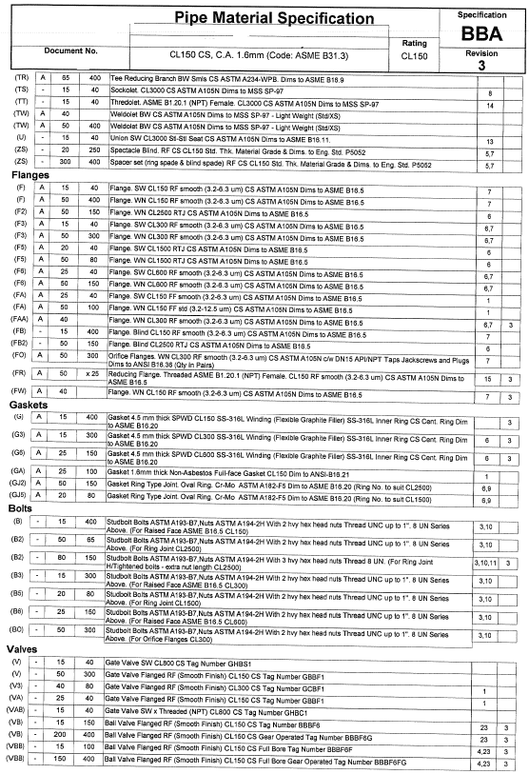
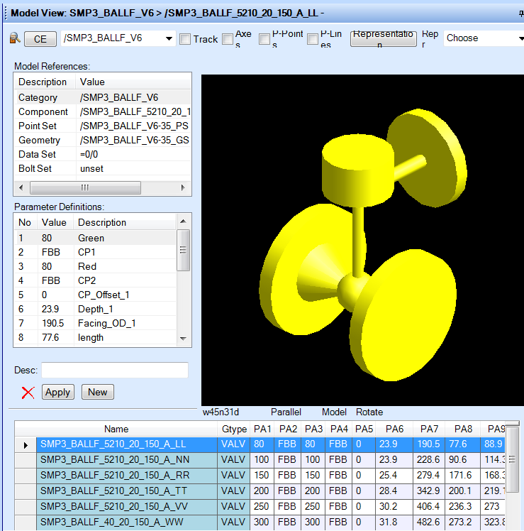
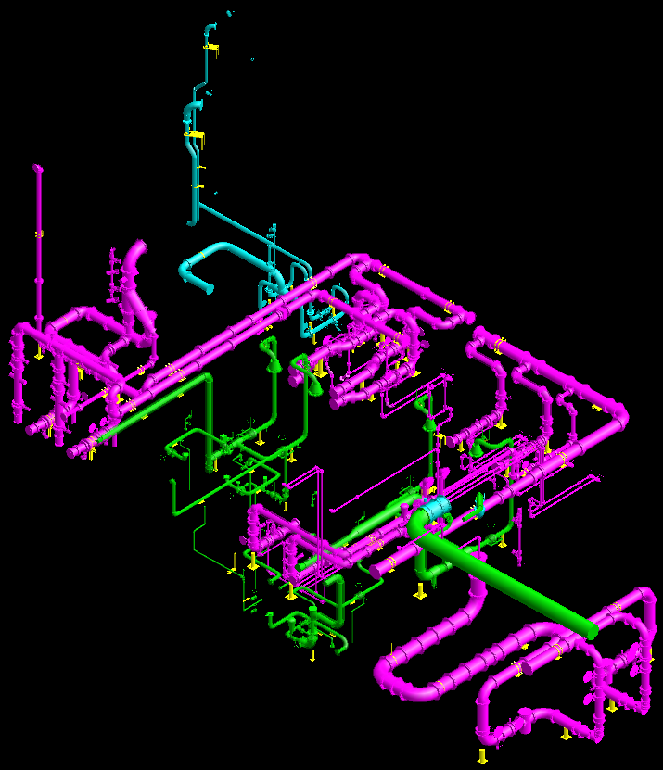
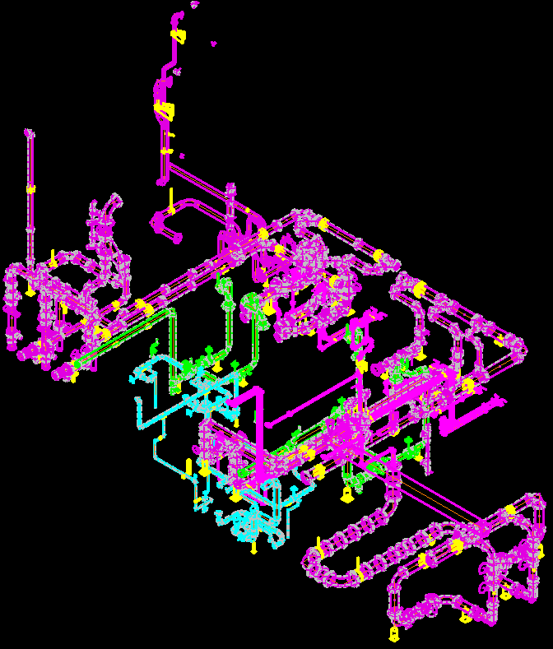
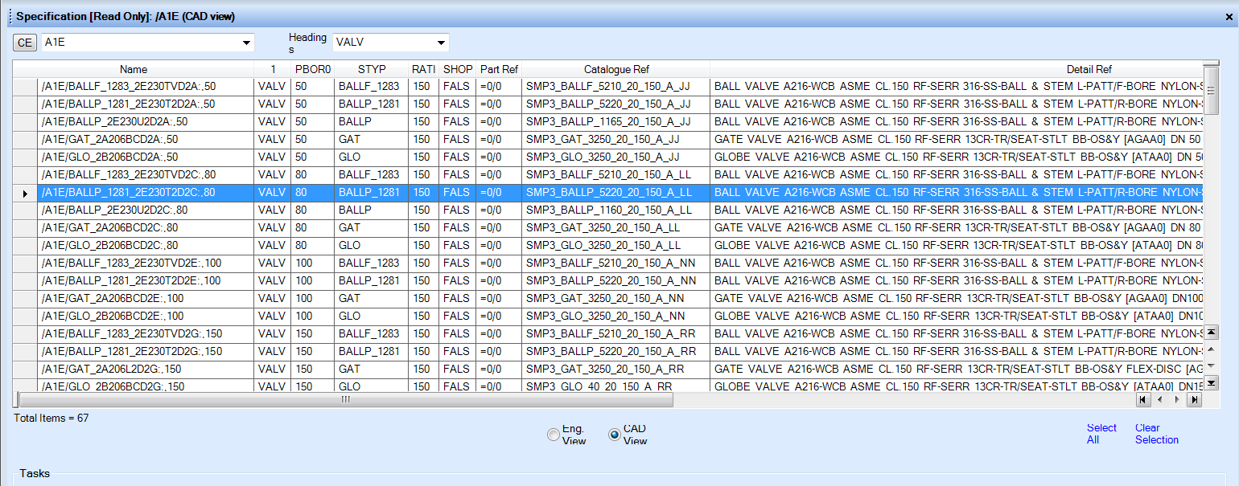
PDS to PDMS conversion
3wilD
Part 1 – Conversion of MicroStation models
Part 2 – Conversion of Pipe Classes
PDS
PDMS/E3D
Files Required
Files Required
Oracle RIS dumps pd*, dd*, ee*.dmp
Microstation DGN, PRP files
Description Files - shbom.L spbom.L
Oracle RIS dumps ra*.dmp
Graphical library, Physical library (*.l.t files)
Description Files – shbom.L spbom.L
Click for Next Slide

Slide 3
PDS (or SP Design Review) to PDMS conversion
3wilD
Part 1 -Conversion of Microstation Models
Client requirements/variables required prior to conversion
Any special UDA attributes to be created/used, eg. UDA field for Part number, Line design conditions, etc
Model area breakdown requirements, eg. by discipline, Model CAD area, SubSystem area.
Line Number format to be used during conversion, eg. Line Number, Isometric number
Nozzle naming convention and Nozzle Spec
Items to note:
Intelligent tags rely on PDS being used for modelling all items for database integrity (eg. not direct modelling in Microstation, although all items will still convert, they will be dumb graphical items only)
All models/disciplines are converted into tagged EQUI items, (but maintain original model and Microstation entity ID number)
Piping items will be created as tagged SUB-EQUI items and maintain shape and part number/description information (if MTO’s are required). EQUI name will be the Line Number.
All piping & structural models convert polyhedron free. Other disciplines minimise use of polyhedrons (minimising impact on graphics performance)
Equipment will be created with Nozzle Names and references if modelled via PDS
Equipment weights can will be transferred to PDMS
Instruments will maintain Tags
Cable tray, cabinets, lighting and other electrical items will maintain Tags if modelled via PDS
All steel sections converted as structural sections Catalogue with Steel Spec & weights, grating and stair treads created as PANELs
Soft clash items will convert as obstructions, eg pipe/equipment insulation/access volumes/grating.
Click for Next Slide

Slide 4
PDS (only) to PDMS conversion
3wilD
Part 2 - Conversion of Pipe Classes
Client requirements/variables required prior to conversion
Part Number UDA to be used for isometric set-up in pipe specs
CoCo Naming convention (otherwise defaults to Aveva SAMPLE project)
Items to note:
Uses OLD bolting method
Inline dimensions and shape primitives converted from PDS data (not recreated in PDMS) including valve operators.
All fitting weights will be transferred from PDS as Component References in PDMS (if available)
Click for Next Slide

Slide 5
PDS (or SP Design Review) to PDMS conversion
3wilD
Costs
Part | Measurable Metric | Cost per Metric | Comments
1 | Microstation Models | $12 per Model | All Disciplines - Equipment, Piping, Raceways, Structural Discipline includes creation of CATA, Catrefs and Structural Spec Equipment Discipline includes creation of Nozz Catrefs and Nozzle Spec
2 | Pipe Class | AUD $400 | Includes creation of CATA/SCOMs, CatRefs, DetRefs, BltRefs, CmpRefs
Part 1 conversion – Files required to convert to PDMS:
If full PDS archive available
If only SP Design Review data available
or
Oracle RIS dumps pd*, dd*, ee*.dmp
Microstation *.dgn, *.prp files
Description Files - shbom.L spbom.L
Design Review *.drv files
Microstation *.dgn, *.prp files
Part 2 conversion – Pipe Classes and catalogue data to PDMS requires files below to be supplied
Oracle RIS dump ra*.dmp
Graphical library, Physical library (*.l.t files)
Description Files – shbom.L spbom.L
NOTE:
Conversions are priced in Australian dollars (excluding GST) based on a single PDS Project (Oracle RIS data set). Conversion of part 1 and 2 are independent of each other and can be done separately over separate time frames if required.
Email: info@Threewild.com
Click for Next Slide

Slide 6
PDS to PDMS conversion
3wilD
Proof of Concept
Prior to Part 1 or Part 2 conversion we offer a Proof of Concept conversion before progressing further or any payments. We will require your PDS data or Smart Plant design Review data to be uploaded to secure FTP site but ensures you will be happy with the conversion before we fully proceed.
A PDMS database will be returned with a sample of one area.
Your data is secure and we will sign non-disclosure agreements prior to any data handover.
Time Frame for Conversion
Typically conversion takes approximately one-two weeks depending on the number of models. Conversion of 1000’s of models is not an issue.
If client UDA requirements are onerous this may add another week to implement.
Click for Next Slide

Slide 7
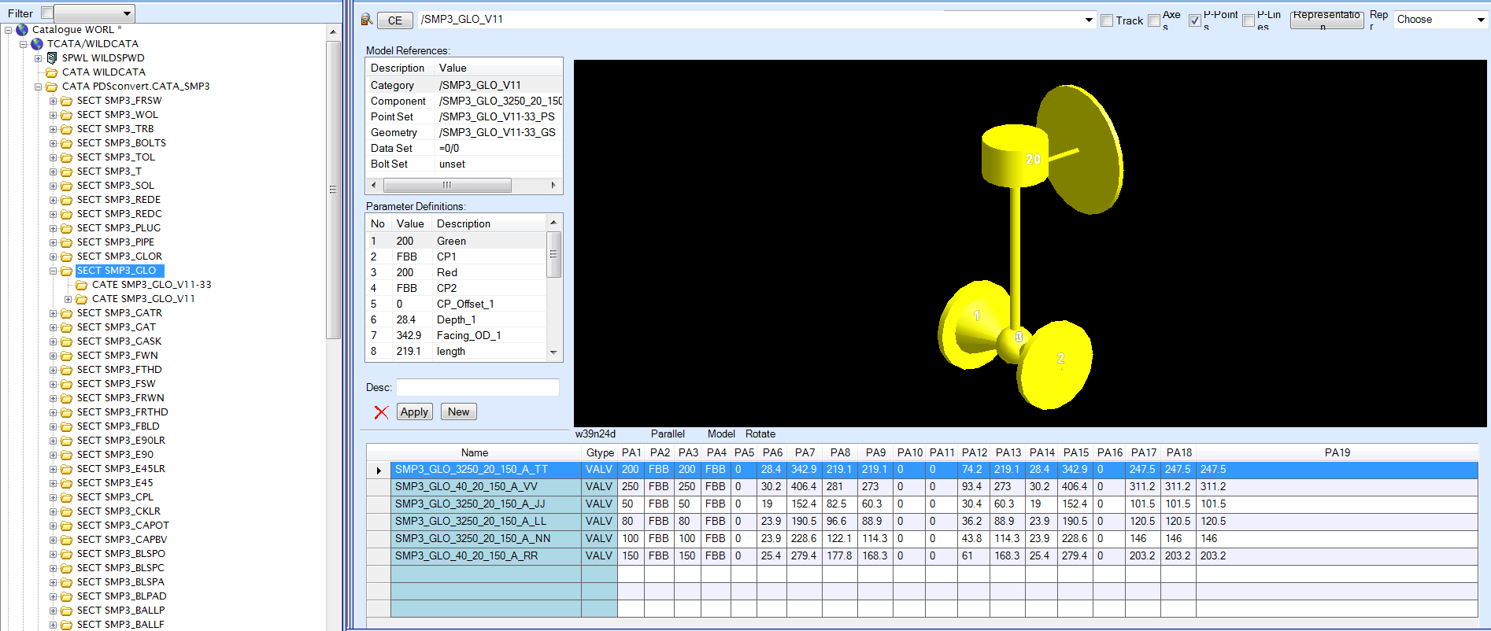
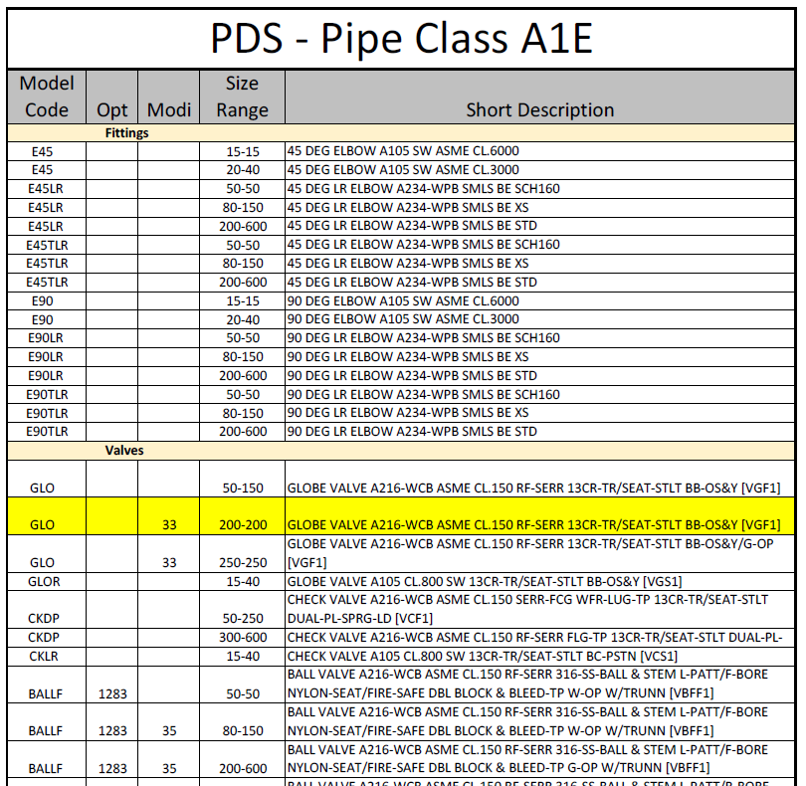
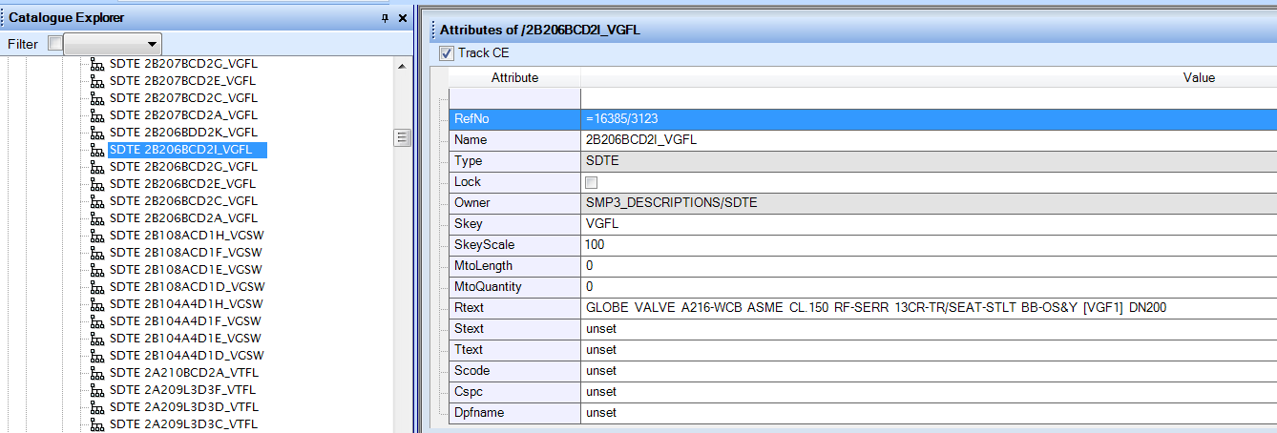
PDS to PDMS conversion - Catalogue
Model Codes and all other dimensional, description & naming information is taken from PDS Spec, Graphical & Physical libraries to form your PDMS reference catalogue data
Click for Next Slide

Slide 8
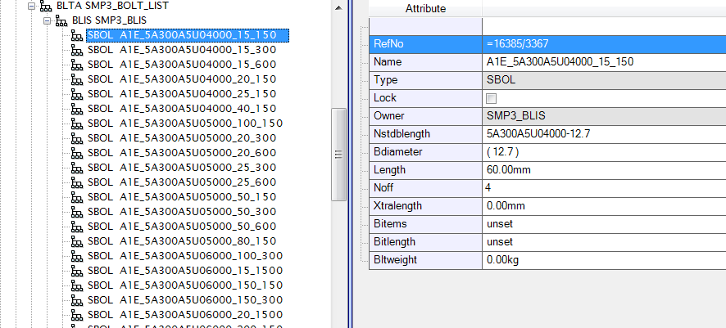
PDS to PDMS conversion - Bolting
Bolt lengths are calculated from PDS data while building the catalogue and provide BoltRef’s and part number array’s for OLD bolting on flanged items so existing bolt part numbers can be used
Click for Next Slide

Slide 9
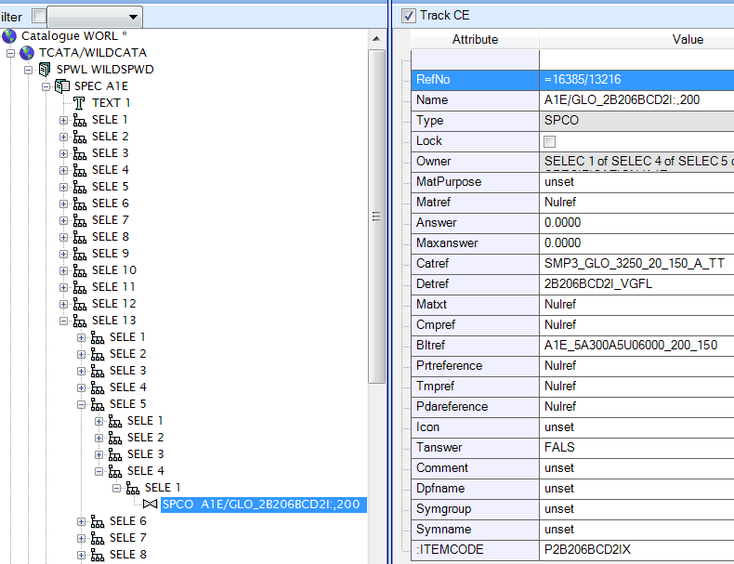
PDS to PDMS conversion – Pipe Classes
NOTE: Weight Component references will also be created and referenced when available in PDS
Pipe Classes are loaded referencing all components available in PDS including original Part Numbers
Click for Next Slide

Slide 10
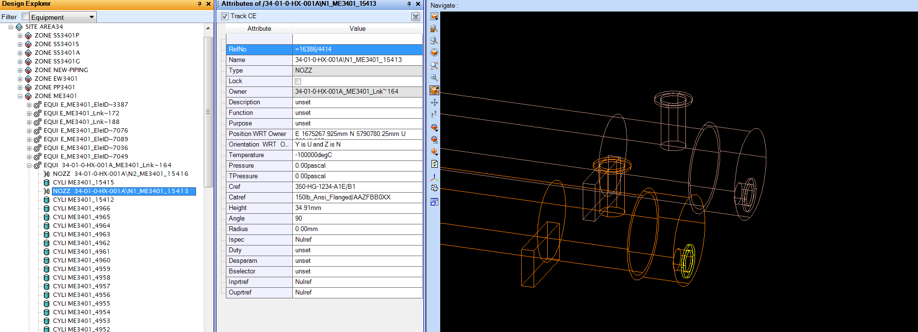
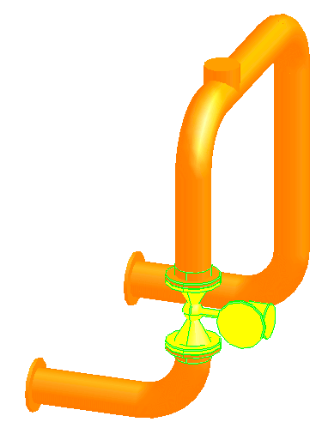
PDS to PDMS conversion - Nozzles
Nozzle references will be created allowing connection of new piping and isometrics
Click for Next Slide

Slide 11
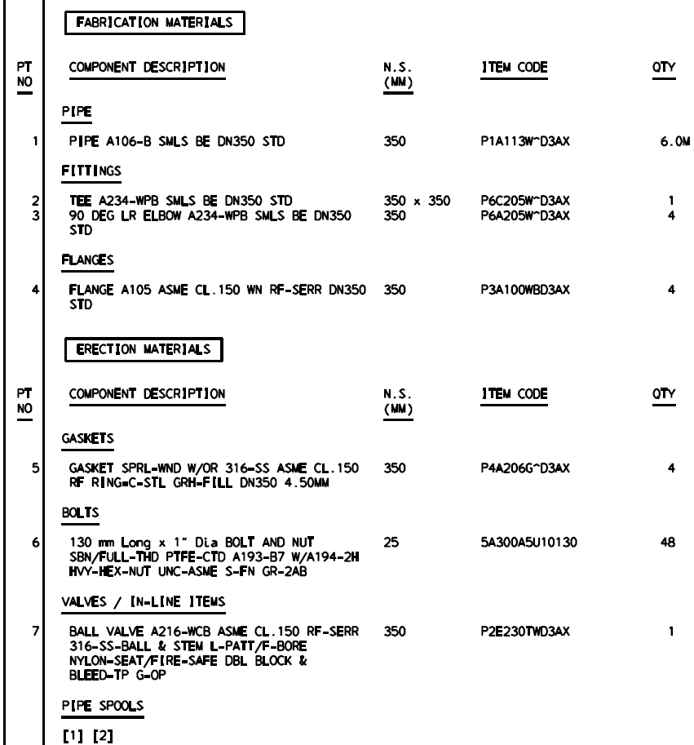
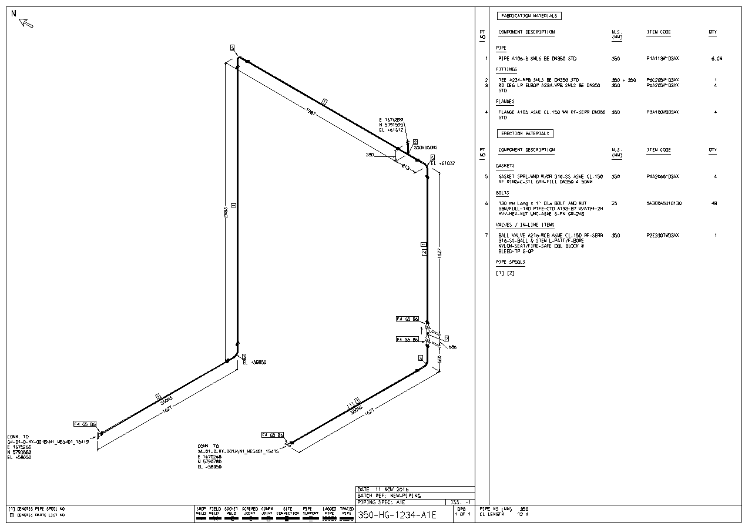
PDS to PDMS conversion - Isometrics
Allows Isodraft isometrics to be generated and issued for fabrication with accurate dimensional pipe class information and part numbers from original PDS data
Click for Next Slide

Slide 12
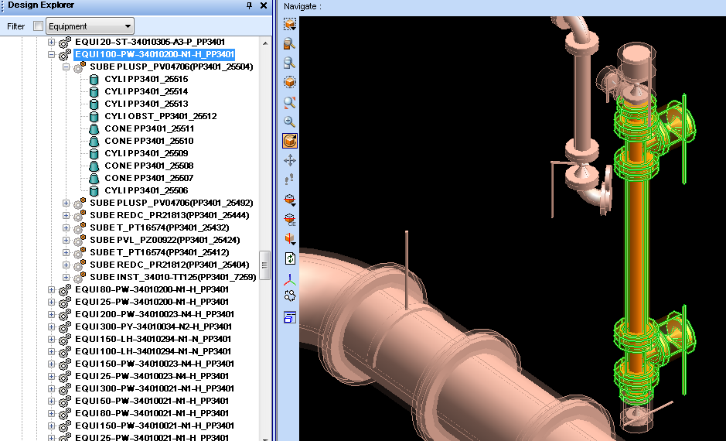
3wilD
PDS to PDMS conversion - Piping
Our hierarchy shows fittings associated with its Line Number enabling easy navigation
Line Number
Fitting
Insulation shown on all fittings
(25% translucent)
No Insulation on this line
Click for Next Slide

Slide 13
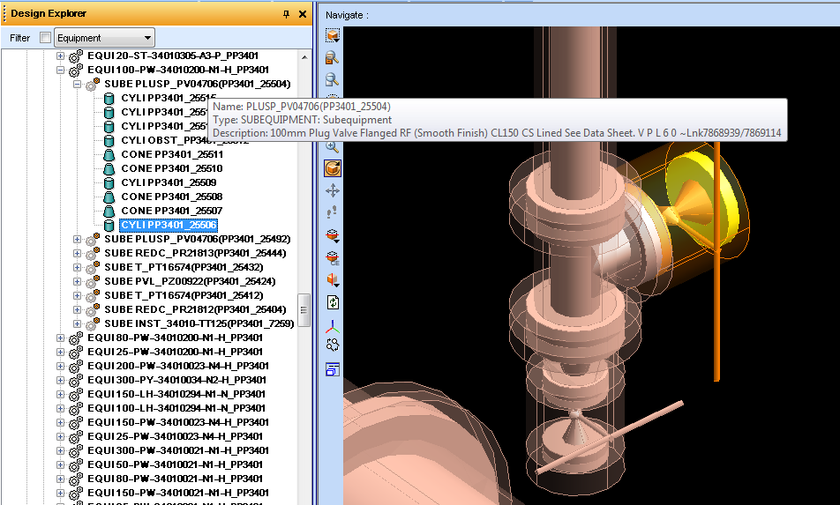
3wilD
PDS to PDMS conversion - Piping
Details of fitting descriptions transferred through
Hover mouse over SUBElement to show
fitting Part Number & Description
Individual fitting shapes selectable in hierarchy
Click for Next Slide

Slide 14
3wilD
PDS to PDMS conversion - Piping
Search for Instrument or Equipment tags using standard PDMS search
With Search Results you can highlight Tags within model
Search For Instrument ‘FE139’
Click for Next Slide

Slide 15
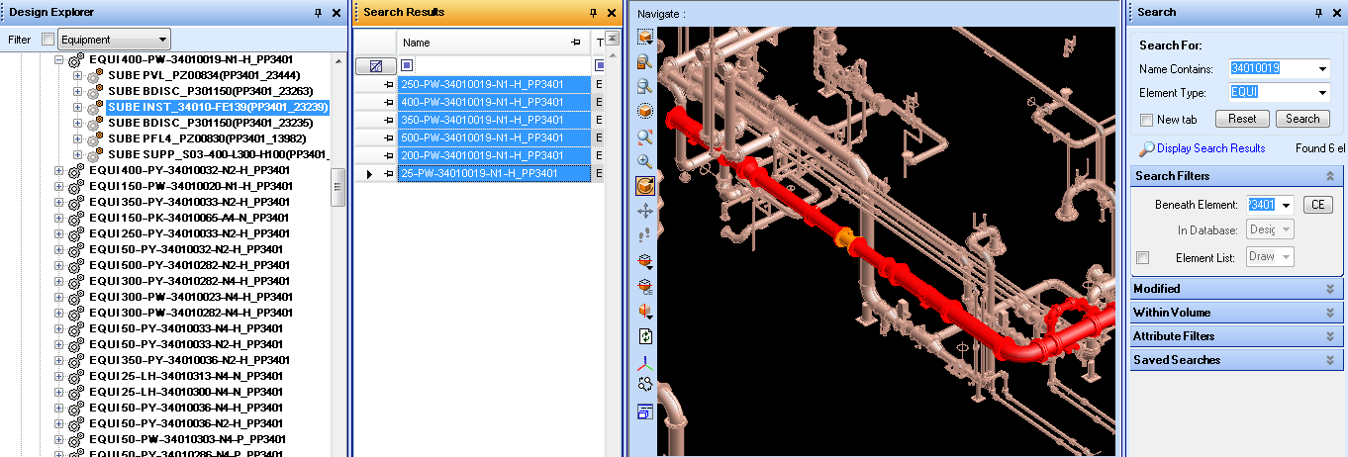
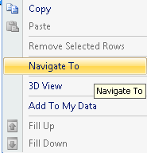
3wilD
PDS to PDMS conversion - Piping
Search for all items on a line using multiple selection
With Search Results you can highlight multiple Lines within model
Search For Line Number ‘34010019’
Click for Next Slide

Slide 16
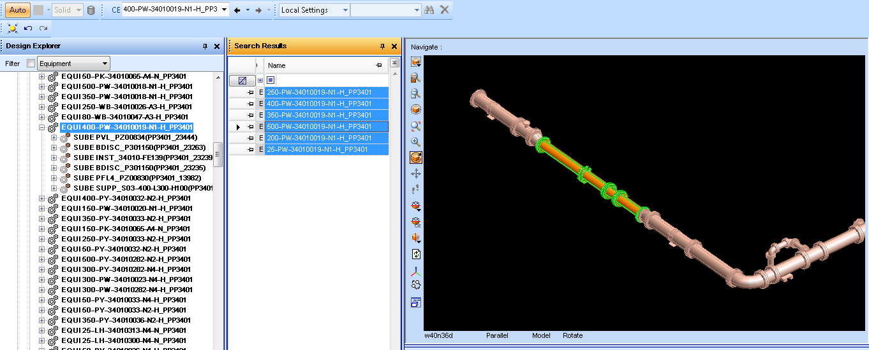
3wilD
PDS to PDMS conversion - Piping
Add only relevant lines to your view using standard PDMS search
You can limit the view to only search results for quick reference
Click for Next Slide

Slide 17
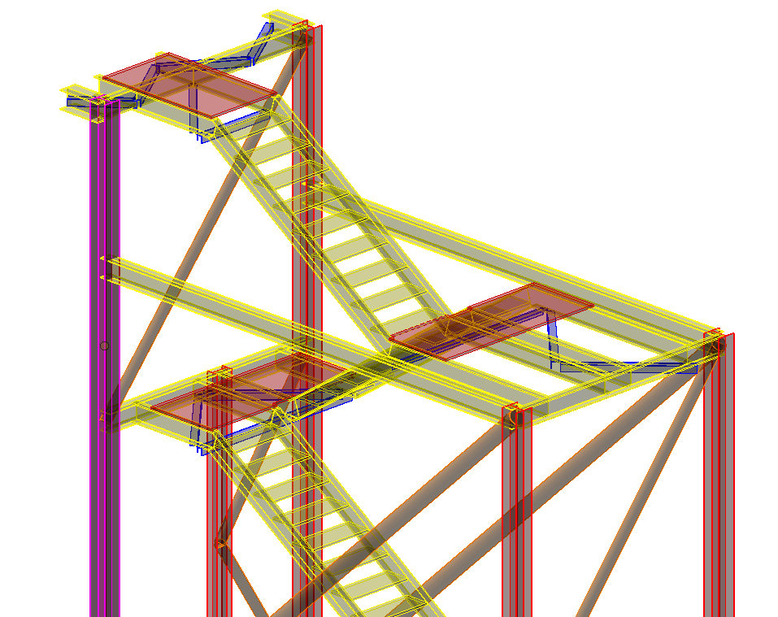
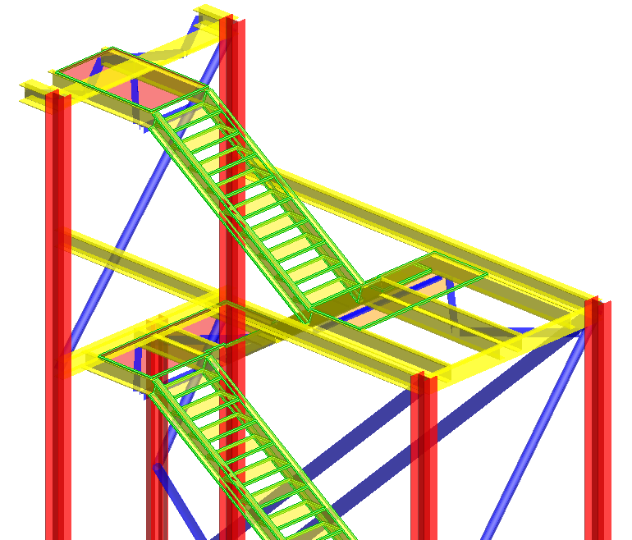
3wilD
PDS to PDMS conversion - Structure
Microstation View
PDMS View
Click for Next Slide

Slide 18
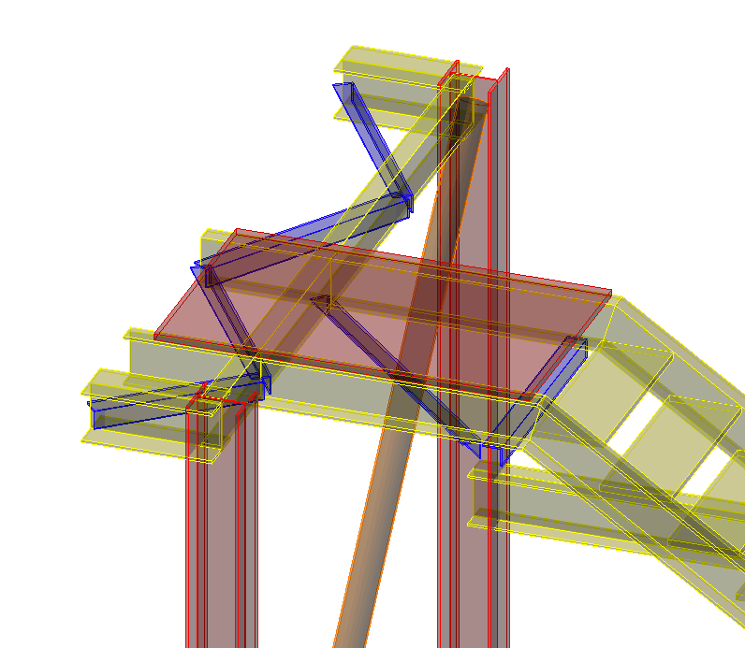
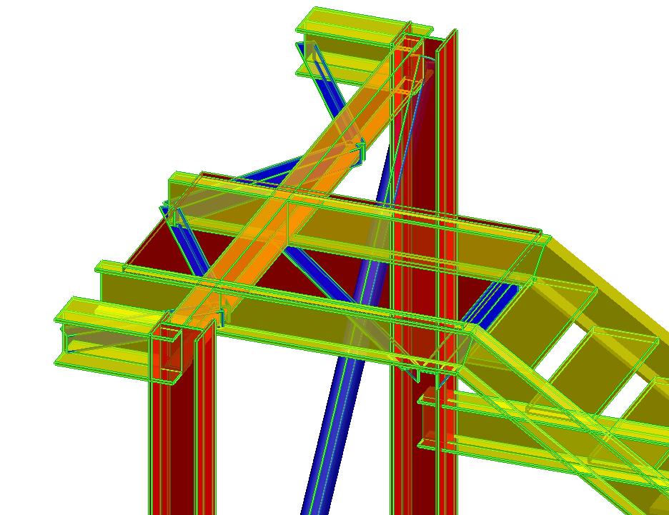
3wilD
PDS to PDMS conversion - Structure
Microstation View
PDMS View
Section cutting profiles are maintained on transfer for steel sections
Click for Next Slide

Slide 19
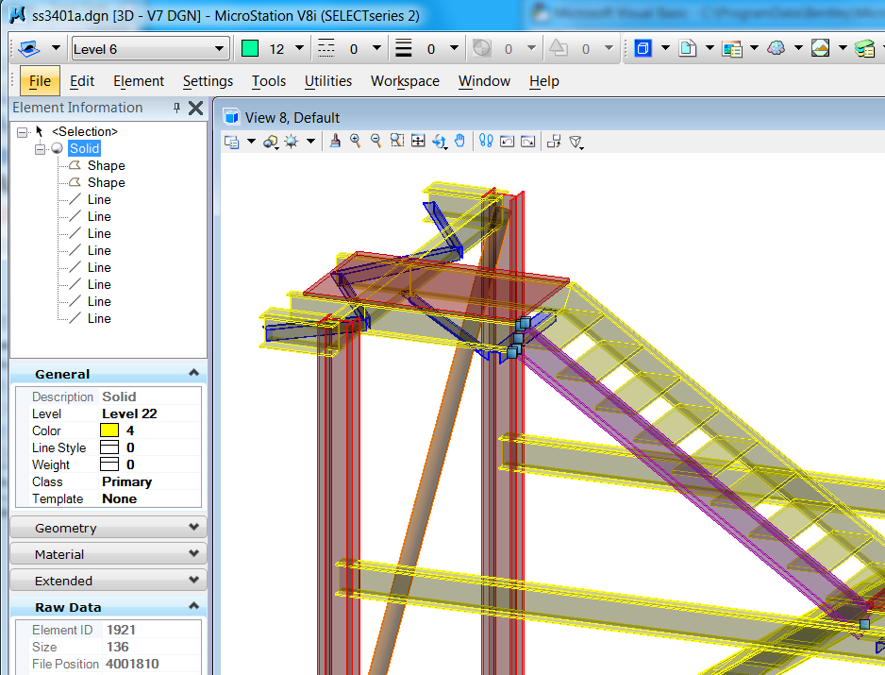
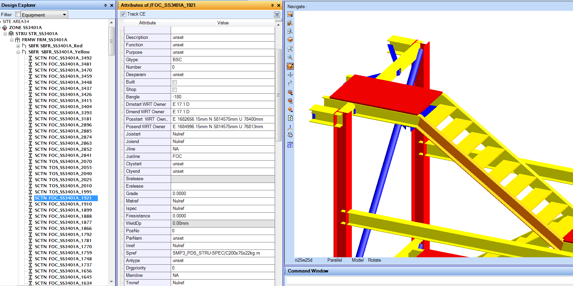
3wilD
PDS to PDMS conversion - Structural
For each structural element:
Elements are grouped in SUBFRAME by original colour
Model and Element ID are maintained from Microstation for traceability
Click for Next Slide

Slide 20
3wilD
PDS to PDMS conversion - Structural
Steel Catalogue and SPREF is created for ALL sections
For each structural element:
Section cutting profiles are maintained
Stair treads and grating are created as structural PANELs
Now you can continue to create accurate structural drawings in PDMS/E3D with your PDS model data
Click for Next Slide

Slide 21
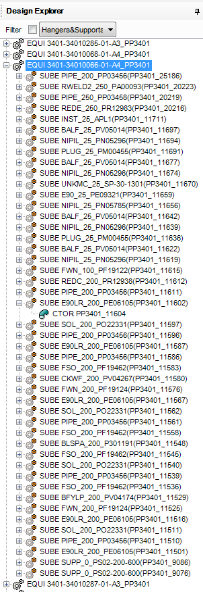
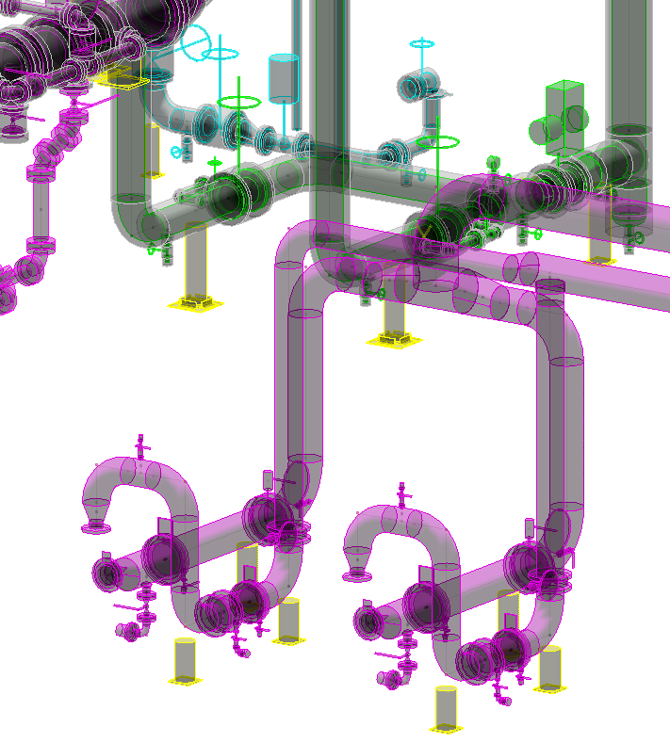
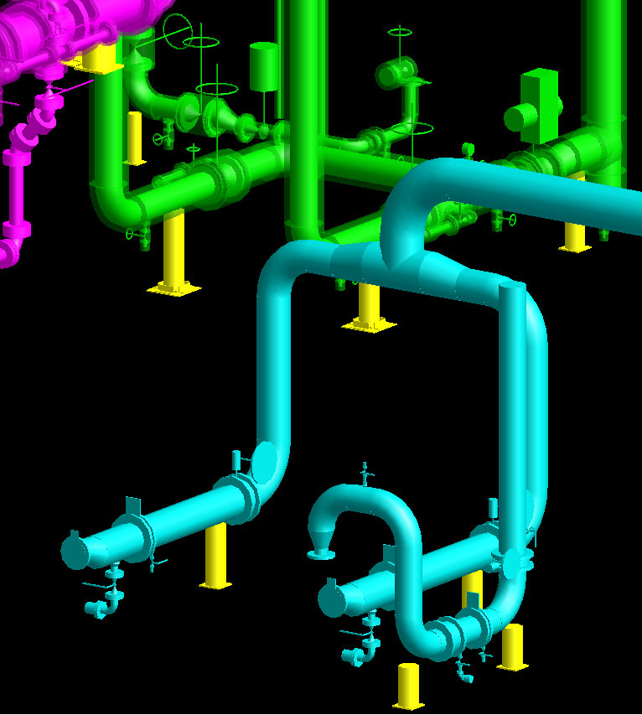
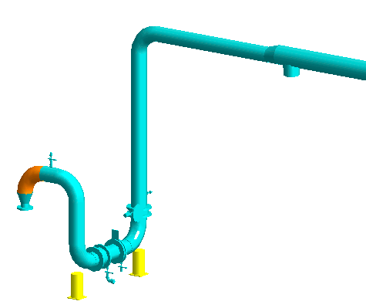
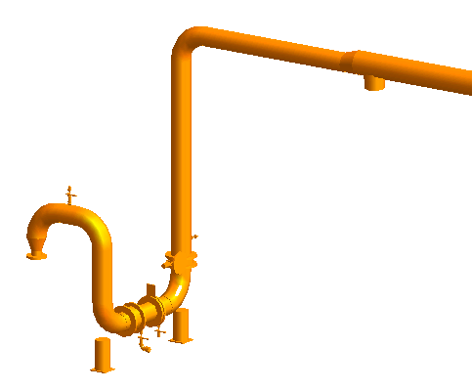
PDS to PDMS conversion
PDS Microstation Before
PDMS/E3D After
Conversion of graphics with one major difference
Full Isometric is selectable in hierarchy
Isometric fittings are selectable in hierarchy with intelligence
Click for Next Slide

Slide 22
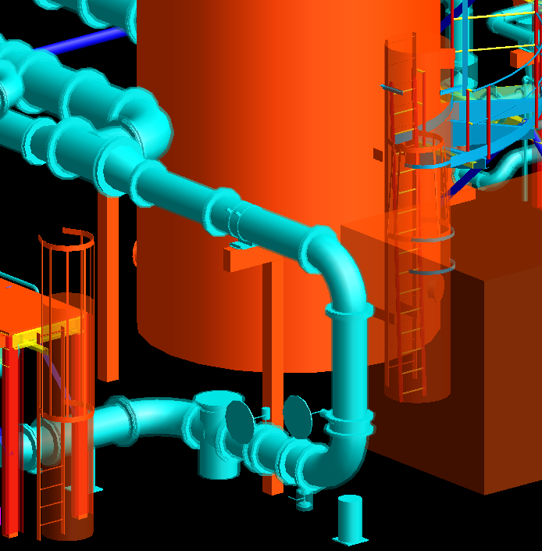
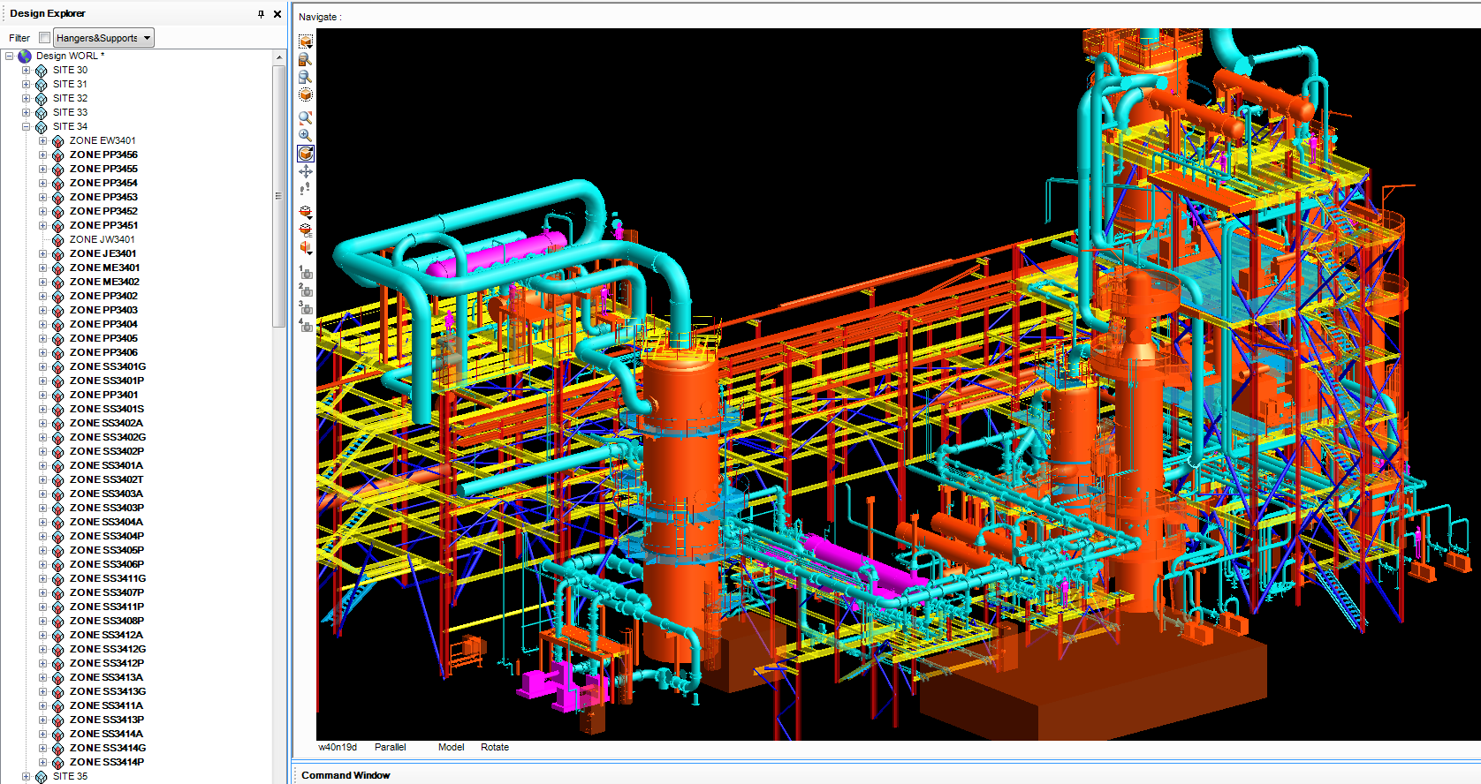
PDS to PDMS conversion - Overview
Steel converted with Catref/Spref and built in SUBFRames with colour rules matching PDS
Audit ability of handover as EQUIpment naming allows colour rule to identify items in PDS database.
Pink Tagged correctly
Orange unnamed
SITE created per area as agreed, containing PDS Microstation model names
All disciplines can be given unique colour rules or be split by Fluid
Obstruction Levels created for:
insulation
access ways
maintenance envelopes
grating
Click for Next Slide

Slide 23
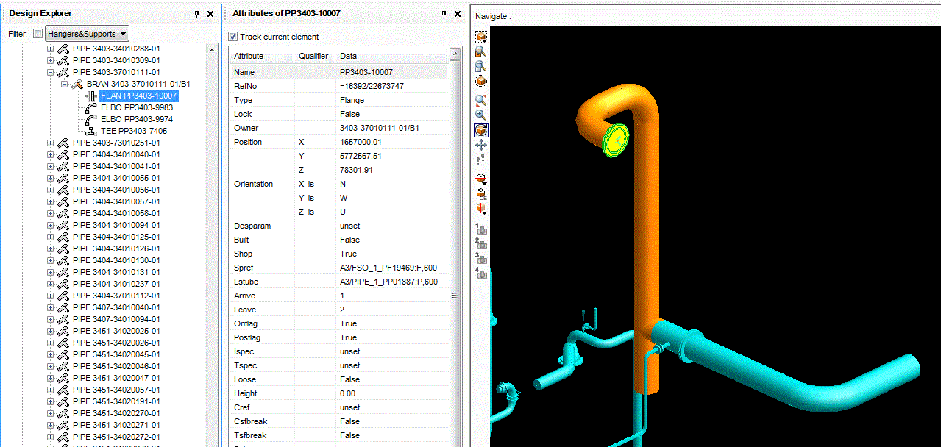
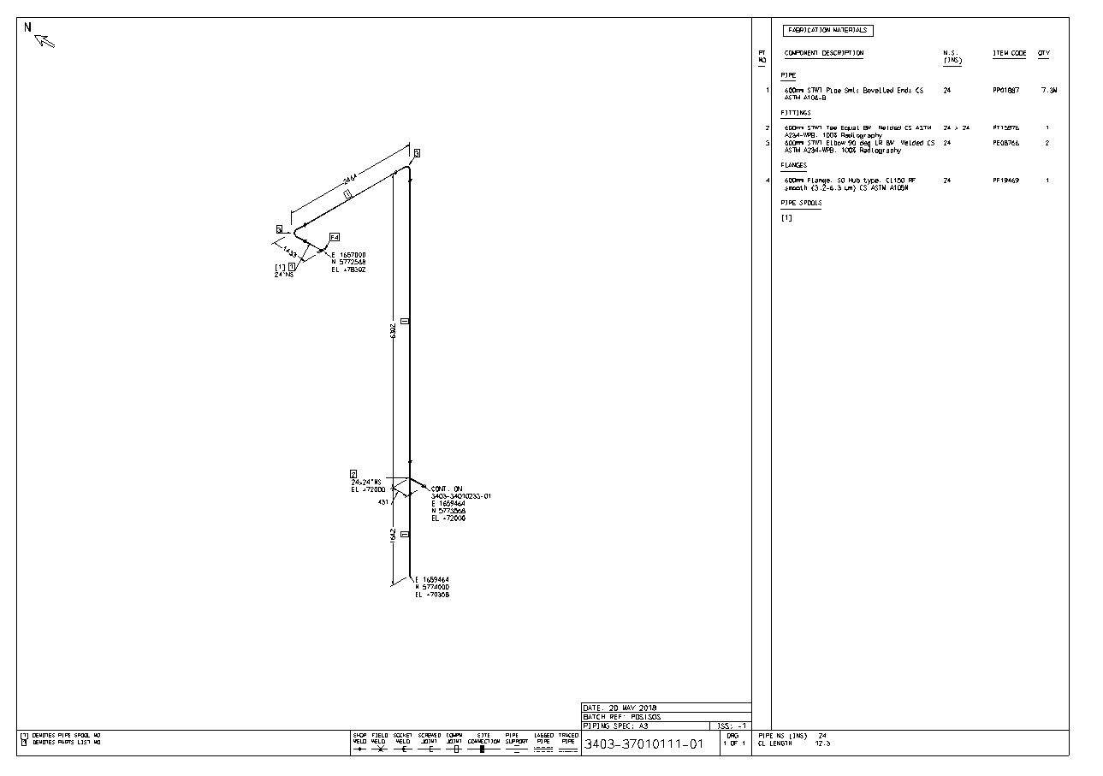
We can also perform a full conversion of your data so you can run existing or new piping isometrics with your converted PDS pipe classes. This will save an enormous amount of time and provide full conversion accuracy!

Slide 24
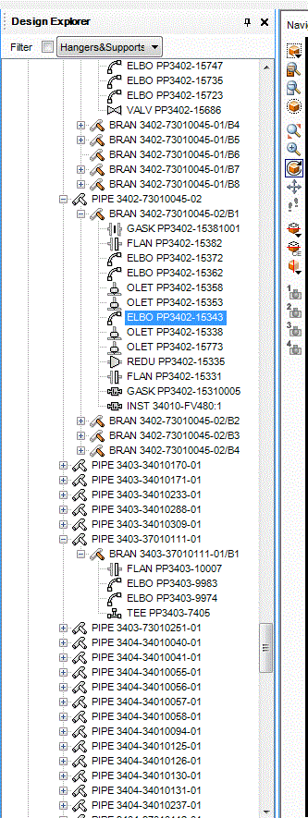
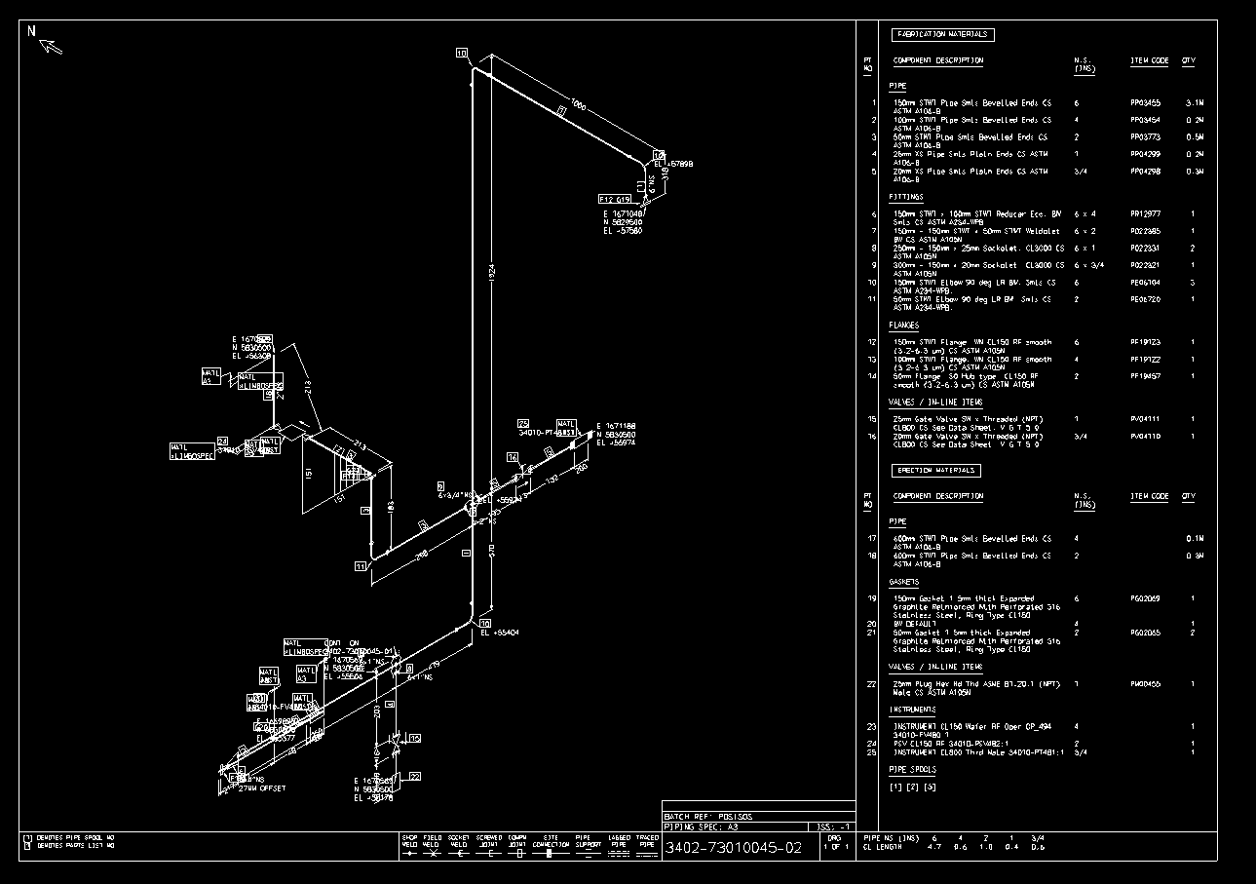
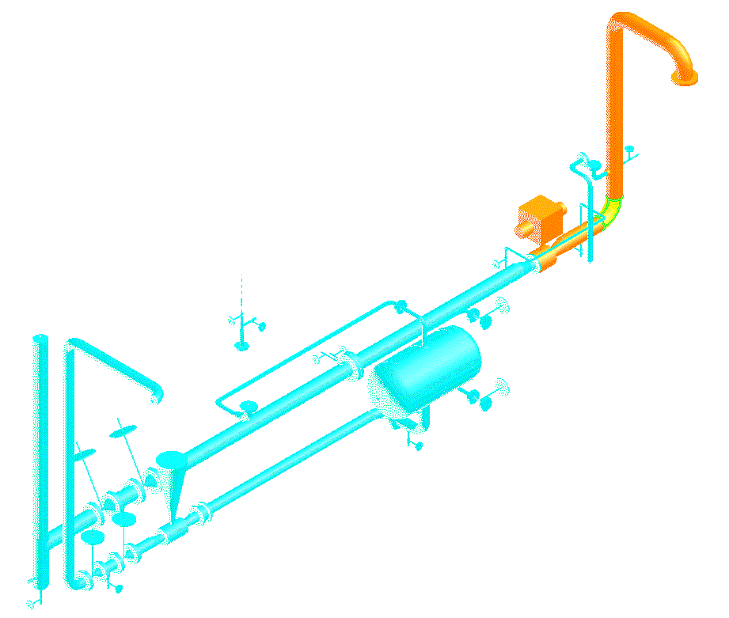
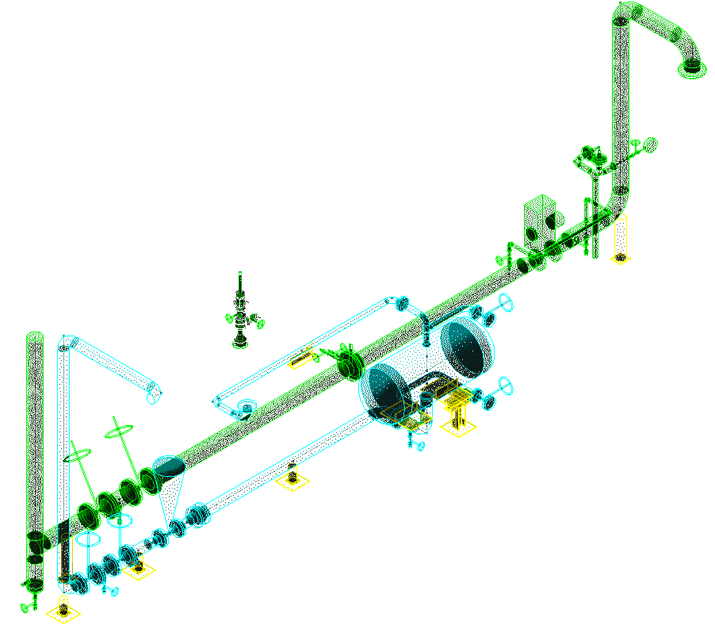
With the Microstation models and Oracle data…
Our software rebuilds the piping models in PDMS
So isometrics can be run

Slide 25
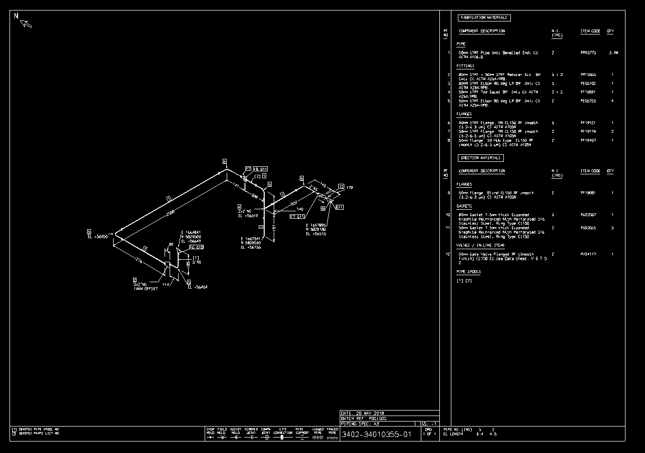
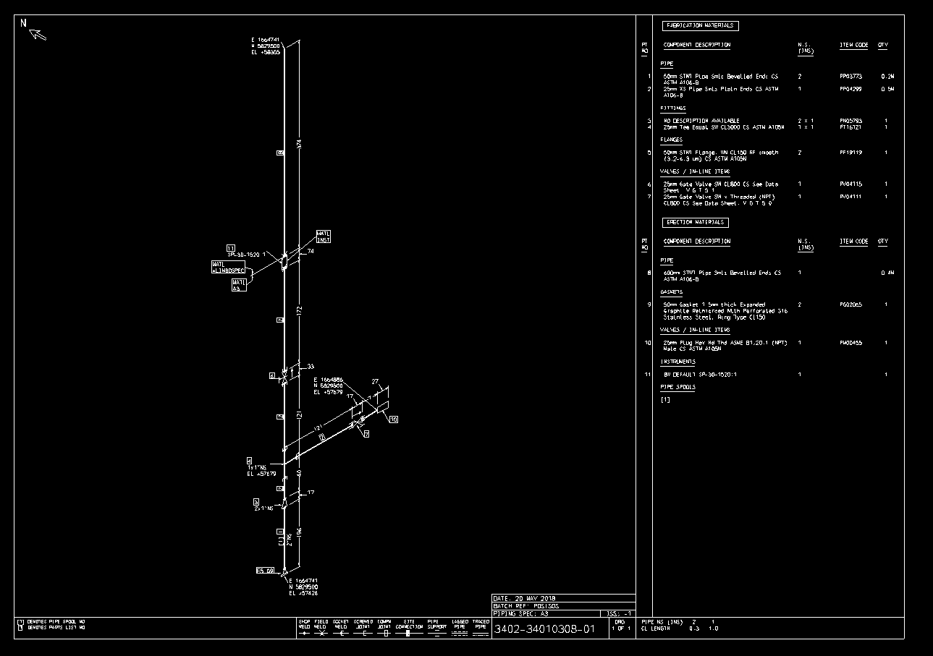
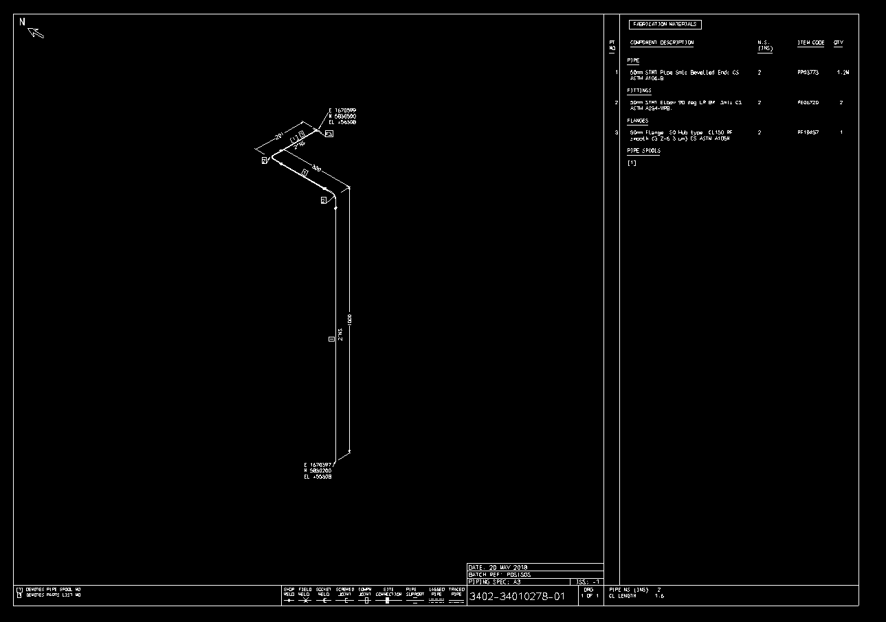
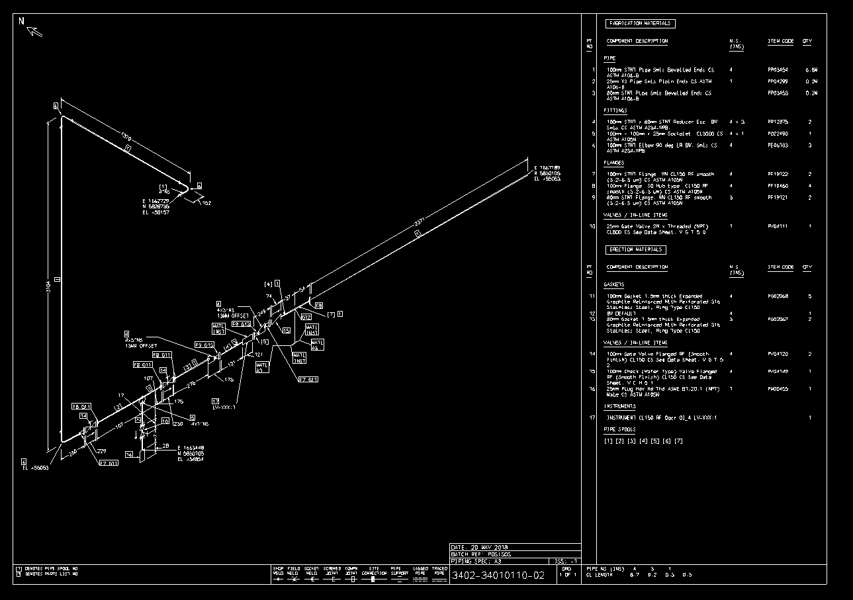
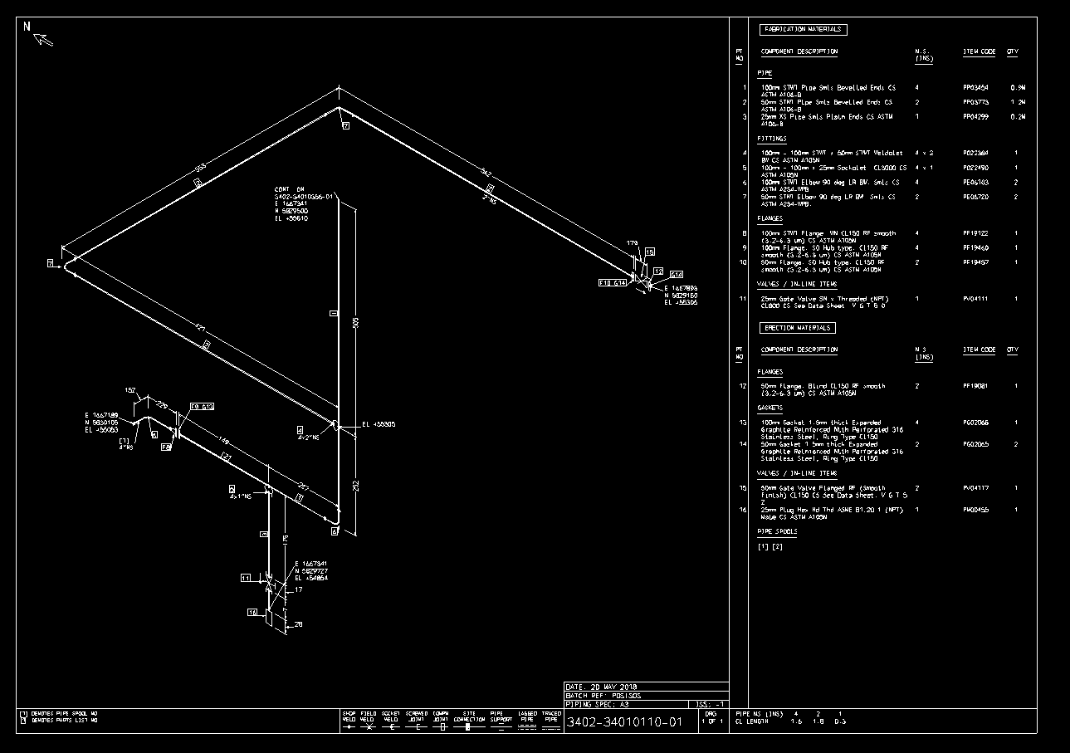
Providing continued 3D data intelligence for life !

Slide 26
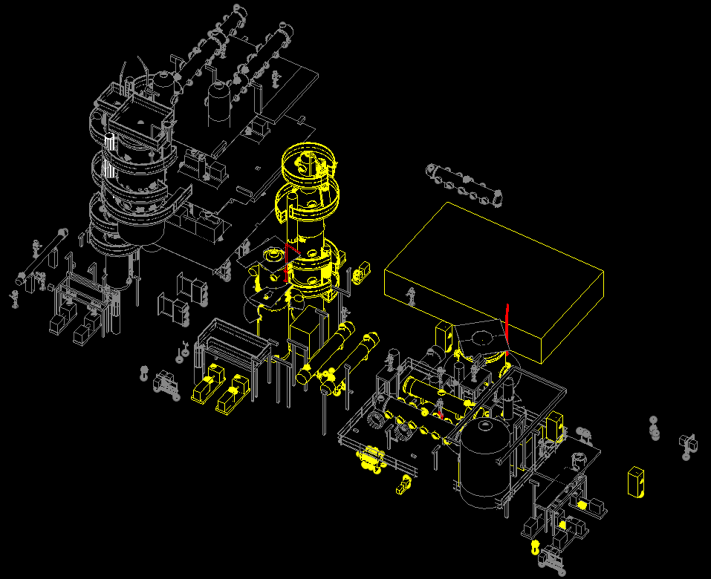
PDS to PDMS conversion - Integrity
Additionally a single ‘error’ Microstation model is created grouping problems
into two colours:
Yellow for objects with missing links to the Oracle database and therefore no intelligence. (These objects will still convert to PDMS.)
Red for objects failing to convert
All other items are shown in grey for reference.
Between these two reporting medium, a reliable audit of conversion can easily be undertaken which is otherwise very difficult on large projects with so much data.

Slide 27
3wilD
PDS to PDMS conversion - Summary
Our conversions will allow you to maintain dimensional accuracy of your existing design plant with all the intelligence it had when originally designed in PDS. Models will continue to have the following functionality:
Touch lines, instruments, equipment, SP items and pipe supports and see original tag numbers and the hierarchy structure they belong to.
Search for ANY tag or part number in your new PDMS database design model, focus on it and relate the design to your P&ID’s easily and accurately for new design work or maintenance operations.
Catalogue and Pipe classes will be converted from PDS dimensional information with original part numbers including bolting.
Weights will be transferred if originally available in PDS.
Nozzle name and connection data will be maintained for modelling of new piping.
Obstructions will be maintained on transfer so insulation, access ways and maintenance corridors can be turned on and off.
Structural sections will ALL be created as Catalogue/Steel Specification items, floor grating and stair treads will be created as PANELs
PDMS provides superior export to design review tools like Navisworks – clients will be impressed with the improved navigation quality available.
Models will be broken down by discipline and hierarchical structure providing easy navigation.
You will easily be able to model new tie-in work in PDMS by simply tracing the tie-in connection fitting in Piping and running new isometrics with fully converted PDS pipe classes.
Our conversions minimize the use of Polyhedrons in PDMS so your graphics won’t get bogged down when moving around in complex models, (piping models contain no polyhedrons when output!)
Microstation objects not linked to the original Oracle database will still be transferred to PDMS with dimensional accuracy, they just won’t have intelligence so you won’t lose anything graphically. Pink and orange colour rules on equipment provide an easy audit for unlinked PDS data.
All PDMS primitives created maintain their Microstation element ID so it’s easy to trace items between both systems.
Audit reports and a visual Microstation model provide a method for review after conversion. This also validates the Intergraph PDS data before handover to clients as non-linked objects are identified.
Threewild.com
email info@threewild.com

